Slide 1


Analysis of the Most Popular Content Categories on Social Buzz
Prepared by
MOKSHA
JAIN

Slide 2


Today's agenda
Project recap
Problem
The Analytics team
Process
Insights
Summary

Slide 3

Social Buzz is a fast-growing social network company that focuses on content by keeping users anonymous and tracking reactions to the content and needs to adapt quickly to its global scale.
Accenture has begun a 3 month POC that focuses on these tasks:
An audit of their big data practice
Recommendations for a Successful IPO
An analysis of their content categories that highlight the top 5 categories with the largest aggregate popularity
Project Recap

Slide 4

Problem
Over 100,000 posts daily
500 million active users over the past 5 years
36,500,000 pieces of content per year
How can the company capitalize on its growing data for scalability?
Analysis of Social Buzz’s Top 5 most popular content categories

Slide 5



ANDREW FLEMING
Chief Technical Architect
The Analytics team
Marcos Rompton
Senior Principle
Moksha Jain
Data Analyst

Slide 6
DATA UNDERSTANDING
Did some review of the provided data sets to understand what would be needed from the data
Process
1
DATA CLEANING
Cleaned the data sets by removing null values, removing outliers for accurate data analysis
2
DATA MODELING
Joined all the datasets for a comprehensive data set for analysis
3
DATA ANALYSIS
Analyzed the data to find the required insights and answer the stakeholder questions
4
UNCOVER INSIGHTS
Dug deeper into the data to uncover more useful insights for more questions the stakeholders might have
5

Slide 7

Insights
16
1897
MAY
REACTIONS TO ‘ANIMAL’ CONTENT POSTS
MONTH WITH MOST POSTS – 2138 POSTS
UNIQUE CONTENT CATEGORIES

Slide 8
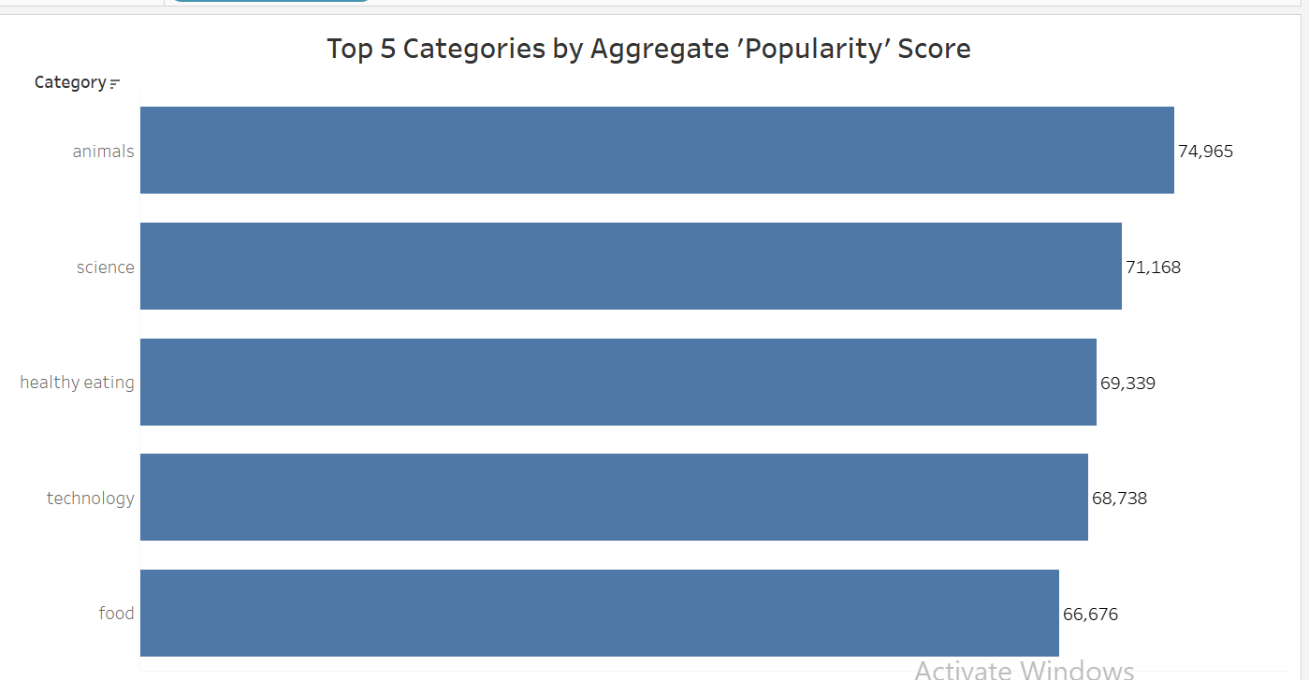

Slide 9
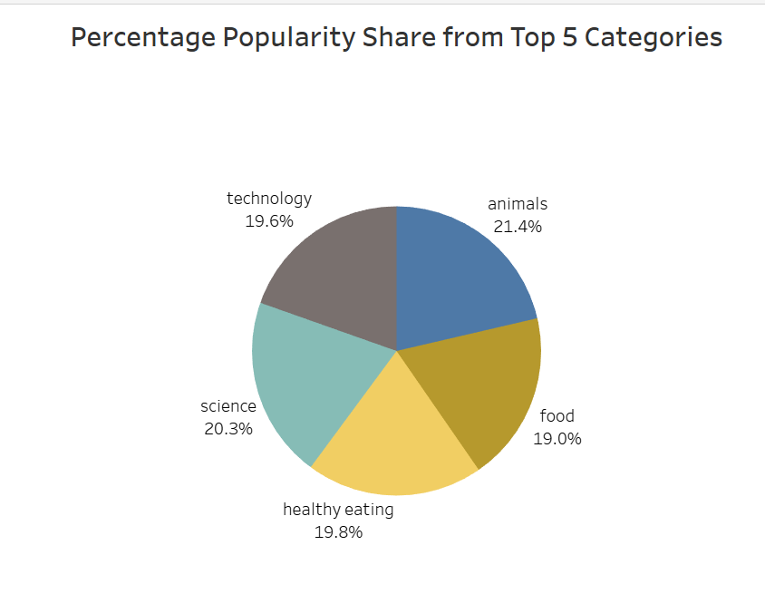

Slide 10
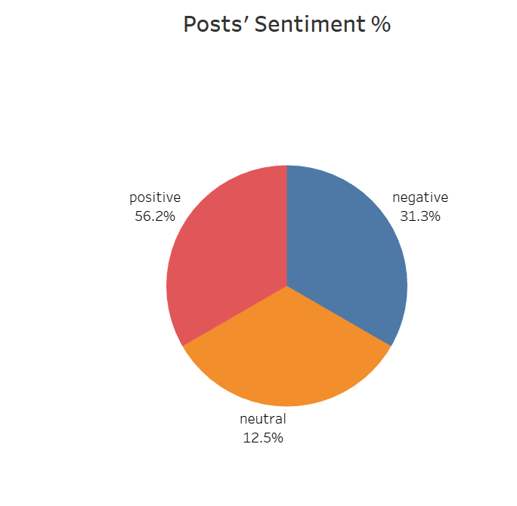

Slide 11

ANALYSIS
Animal and Science content are the 2 most popular content categories showing that people enjoy ‘real-life’ and ‘factual’ content the most
Most people generally have a positive engagement with content posted on Social Buzz
INSIGHTS
Food is a common theme in the top 5 categories with “Healthy Eating” ranking the highest. This may give an indication to the audience within your user base. You could use this insight to create a campaign and work with healthy eating brands to increase user engagement.
Users enjoy ‘factual’ and ‘real-life’ content, you can create an algorithm that promotes the most interesting content to easily go viral.
Summary
NEXT STEPS
This ad-hoc analysis is insightful, but it’s time to take this analysis into large-scale production for a real-time understanding of your business. Accenture can help you know how to do this.

Slide 12
Thank you!
ANY QUESTIONS?

